Slide 1


Cyber-Bullying Detection
Vince Reyes
Ronald Roldan
Keishner Romero

Slide 2


What is Cyber-Bullying
is a form of bullying or harassment using electronic forms of contact, repeatedly and over time against a victim who cannot easily defend him or herself
For more info: https://en.wikipedia.org/wiki/Cyberbullying

Slide 3
Source of Data
Twitter Data
Twitter Streaming API
API that gets the input Tweets and performs any parsing, filtering, and/or aggregation needed before storing the result to a data store.
For more info: https://dev.twitter.com/streaming/overview

Slide 4
Program Flow
-
Iterative process
As the number of iterations increase, the database will increase as well, leading to a better trained model.

Slide 5
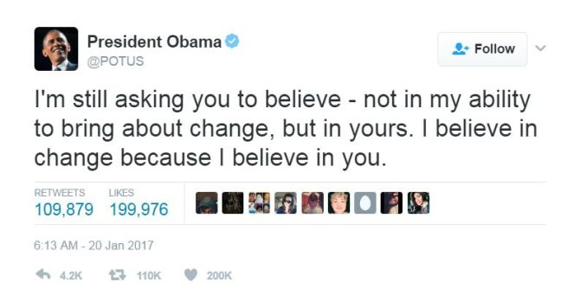
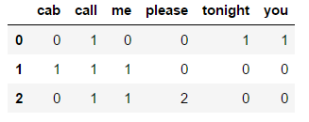
Feature Description
Tweets on social media
Text changed to Document Term Matrix

Slide 6
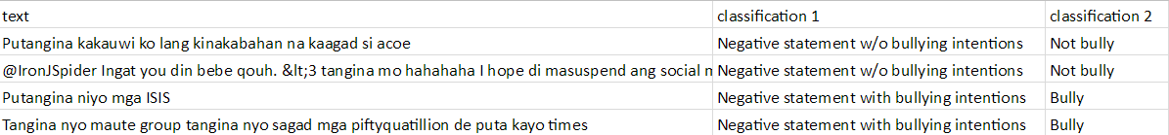
Preprocessing
Unlabeled tweets will be labelled whether it is a bullying statement or not
Classification 1 | Classification 2
Negative Statement w/ Bullying intention | Bully Statement
Negative Statement w/o Bullying intention | Not Bully Statement
Neutral Statement

Slide 7
Testing Method
Naïve Bayes – good for classifying categorical variables
Database is used for training the model.
New data is predicted using the trained model.
Output is a report containing list of tweets with the corresponding prediction

Slide 8
Post Processing
The report generated by the system will be reviewed by a security officer. The report contains input text, prediction, location, screen name.
If there are mistakes in the prediction, the security officer should make the necessary corrections.
Once all classifications are correct, the new data will be added to the database.

Slide 9
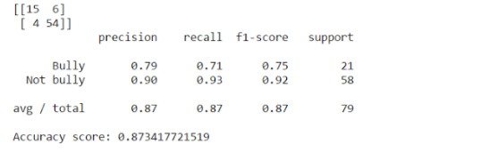
Performance Metrics
Confusion Matrix
Classification Report
Accuracy Score

Slide 10
Demo
Jupyter Notebook

